Slide 1

AI-Driven Academic Risk & Dropout Early-Warning System using Digital Twin
Presented by
Altrin Benser A - 962223205010 John Jins J - 962223205032
Jerish Rethna J - 962223205029 Mukhilan S - 962223205040
Guide:
Er. P Agnes Alex Rathy ME., MBA.
Assistant Professor – IT, SXCCE
Notes:
1

Slide 2
Abstract
Traditional academic systems mainly identify weak students after semester or examination results and treat student information as static records. This limits continuous monitoring and early intervention for academically struggling students.
Our proposed Digital Class Twin continuously collects student attendance, assessment, quiz and behavioral data as events. It maintains an evolving digital representation of each student’s academic state over time.
Machine learning techniques analyse these data to identify and classify students based on their academic risk.
Notes:
5

Slide 3
Problem Statement
Existing Problems
  Weak students are often identified only after examination/semester results.
  Student data is commonly maintained as static records.
  Static records do not adequately represent changing student performance over time.
  Rule-based approaches such as attendance thresholds cannot capture the complete academic situation.
  Institutions lack an intelligent mechanism for continuous monitoring and early intervention.
Need for the project
To design a system that can continuously monitor student progress, identify declining academic students at an early stage, and provide understandable evidence to teachers and counselors.
Notes:
3

Slide 4
Objectives
To design a system for continuously collecting student academic and behavioural data.
  Attendance
  Assessment
  Behavioural records
To develop a Digital Twin for each student.
  Current academic state
  Historical time-series data
  Synchronization status
To develop a machine learning model to predict academic risk as Low, Medium, or High.
To design a machine learning-based model for predicting future GPA.
To analyze student academic trajectories and classify them as Declining, Stable, or Recovering.
Notes:
3

Slide 5
Literature Survey
Notes:
3

Slide 6
SI NO. | Author(s) & Year | Paper Title | Dataset / Application | Method / Technique Used | Limitations | Key Findings
1 | Cagliero et al. (2021) | Predicting Student Academic Performance by Means of Associative Classification | Learning analytics/course data | • Associative classification • Early exam-success prediction | • Course/exam focused • No continuous Digital Twin or intervention history | • Early data can predict exam success • Supports targeted help for at-risk students
2 | Karalar et al. (2021) | Predicting Students at Risk of Academic Failure Using Ensemble Model During Pandemic in a Distance Learning System | Moodle + Adobe Connect | • Ensemble ML • GB, QDA, DT, RF, ET, LR, ANN | Pandemic/distance-learning context Limited continuous multi-source monitoring | Ensemble model identified at-risk students Asynchronous activity was highly informative
3 | Park & Yoo (2021) | Early Dropout Prediction in Online Learning of University Using Machine Learning | University online-learning data | • ML classification • Early dropout prediction | Online-learning focused No persistent student-state model or intervention loop | ML can identify potential dropouts early
4 | Dabhade et al. (2021) | Educational Data Mining for Predicting Students’ Academic Performance Using Machine Learning Algorithms | Academic, personal and behavioral data | •Educational Data Mining •Comparative ML | •Conventional prediction approach • No Digital Twin or closed-loop intervention | • Multiple student factors support performance prediction
Notes:
3

Slide 7
5 | Tamada et al. (2022) | Predicting Students at Risk of Dropout in Technical Course Using LMS Logs | • Random Forest, DT, NB • K-means + feature engineering | • 1 million Moodle logs | • RF performed strongly • LMS engagement was useful for early prediction | • LMS/technical-course focused • Broader academic and behavioural events not integrated
6 | Yağcı (2022) | Educational Data Mining: Prediction of Students’ Academic Performance Using Machine Learning Algorithms | • Educational Data Mining • Supervised ML | • Student academic dataset | • ML identified patterns linked to academic achievement | • Dataset-level prediction • No continuously updated student state
7 | Oqaidi et al. (2022) | Towards a Students’ Dropout Prediction Model in Higher Education Institutions Using Machine Learning Algorithms | • ML classification • Feature selection + evaluation | • Higher-education student data | Feature selection and model choice affect dropout prediction | • Prediction focused • No Digital Twin or intervention feedback
8 | Segura et al. (2022) | Machine Learning Prediction of University Student Dropout: Does Preference Play a Key Role? | • SVM, DT, ANN, LR • Feature analysis | • University of Madrid • 28 variables | • First-semester performance improves dropout detection • Course preference is relevant | • Very-early prediction remains limited • Single institutional context
Notes:
3

Slide 8
9 | Katsuragi & Tanaka (2022) | Dropout Prediction by Interpretable Machine Learning Model Towards Preventing Student Dropout | • Interpretable ML • Learning+ communication features | • Online-school data • Daily learning + Slack activity | • Behaviour and communication can support dropout prediction | • Online context • No multi-source Digital Twin
10 | Su et al. (2022) | Applying Machine Learning Tecnologies to explore Students Learning Features and performance Prediction | • RF, SVM, LR, NN • Correlation analysis | • Programming- course quizzes + system logs | • Learning behaviour correlated with performance • NN performed well | • Programming-course focused • Limited broader academic/behavioural data
11 | Plak et al. (2022) | Early Warning Systems for More Effective Student Counselling in Higher Education | • LR, additive LR, SVM, RF • Early-warning + counseling | • VU Amsterdam • Two first-year cohorts | •Prediction can support student-specific counselling | • Institution-specific •Intervention depends on local counselling practice
12 | Qin et al. (2023) | Early Warning of Student Performance With Integration of Subjective and Objective Elements | • Neural network • Multi-source data synthesis + cost-sensitive learning | • University records • Academic,library, registration, access- control data | • Combining academic + behavioural factors improved warning | • Institution-specific integration • Deep-model interpretability remains challenging
Notes:
3

Slide 9
13 | Cho et al. (2023) | A Study on Dropout Prediction for University Students Using Machine Learning | • Machine learning • Dropout prediction + feature analysis | •University student records | • ML identified useful dropout-related factors | • Dropout focused • No continuous state tracking or intervention loop
14 | Balcioğlu & Artar (2023) | Predicting Academic Performance of Students with Machine Learning | • DT, SVM, NN • Ensemble model | • OULAD | • Ensemble achieved strong prediction performance | • Performance prediction focused • No persistent twin + XAI intervention workflow
15 | Nagy & Molontay (2023) | Interpretable Dropout Prediction: Towards XAI-Based Personalized Intervention | • ML dropout prediction • Explainable AI | •Higher-education student data | • Interpretability can support personalized intervention | • Mainly prediction + explanation • No event-driven Digital Twin trajectory
16 | Villar & Robledo Velini de Andrade (2024) | Supervised Machine Learning Algorithms for Predicting Student Dropout and Academic Success: A Comparative Study | • DT, SVM, RF, GB, XGBoost, CatBoost, LightGBM • SMOTE/ADASYN + SHAP | •Higher-education dataset | • Boosting models performed strongly • SHAP supported factor interpretation | • Single-dataset dependence • Minority-class prediction remains challenging
Notes:
3

Slide 10
17 | Vaarma & Li (2024) | Predicting Student Dropouts with Machine Learning: An Empirical Study in Finnish Higher Education | • ML prediction • Monthly longitudinal feature analysis | • Finish higher education •Transcript + demographic + Moodle data | • Credits, failed courses and Moodle activity were important • Feature importance changes over time | • Single-university confidential data • Requires continual updating
18 | Tiukhova et al. (2024) | Explainable Learning Analytics: Assessing the Stability of Student Success Prediction Models by Means of Explainable AI | • Predictive learning analytics • SHAP + model-stability/drift analysis | • Student success prediction data | • SHAP helps assess feature importance and stability •Importance changes across contexts | • Explainability focused • Not a complete early- warning/intervention platform
19 | Miranda et al. (2024) | Machine Learning's Model-Agnostic Interpretability on the Prediction of Students' Academic Performance in Video-Conference-Assisted Online Learning | • RF, SVM,GNB • SMOTE + SHAP | • 361 online-learning records | • RF performed strongly • SHAP identified important performance factors | • Small, context-specific dataset • Online/pandemic context limits generalization
20 | Alalawi et al. (2025) | An Extended Learning Analytics Framework Integrating Machine Learning and Pedagogical Approaches for Student Performance Prediction and Intervention | •Predictive ML + pedagogical intervention • Web-based learning analytics framework | • Course assessment data • Academic pilot | • Connects prediction with intervention • Web framework supports academics | • Intervention depends on academics • Continuous multi-source event integration remains open
Notes:
3

Slide 11
Literature Summary
Major Methods
Common Limitations
  Many studies use static or institution-specific datasets.
  Most focus mainly on prediction rather than continuous monitoring.
  Limited integration of academic, attendance and behavioural events.
  Few systems connect predictions directly with interventions.
  Machine Learning: Random Forest, Decision Tree,
  SVM, Logistic Regression
  2. Ensemble & Boosting methods for dropout prediction
  3. Educational Data Mining and Learning Analytics
  4. SHAP / Explainable AI for prediction interpretation
  5. Digital Twin & graph-based student pathway modelling
Key Findings
Relevance to Proposed Project
  ML can predict academic performance and dropout risk at an early stage.
  Attendance, academic performance, LMS activity and behaviour are important indicators.
  Combining multiple student data sources improves risk prediction.
  XAI helps identify the factors influencing predictions.
  Our Digital Class Twin extends existing ML and Digital Twin approaches.
  Uses event-driven continuous monitoring and time-series student state.
  Provides Low/Medium/High risk, GPA prediction and trajectory-based urgency.
  Uses SHAP, What-If simulation and intervention logging for actionable decisions.
Notes:
3

Slide 12
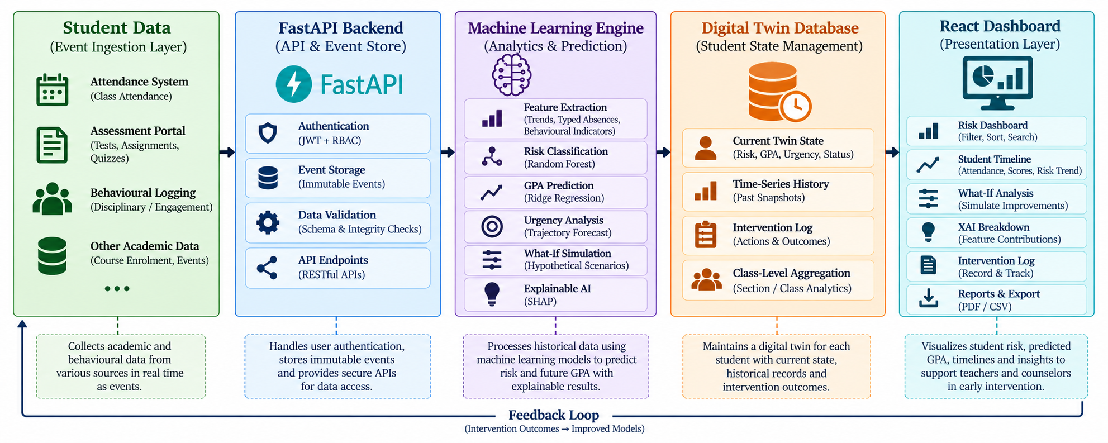


Proposed Solution
System Architecture
Notes:
6

Slide 13
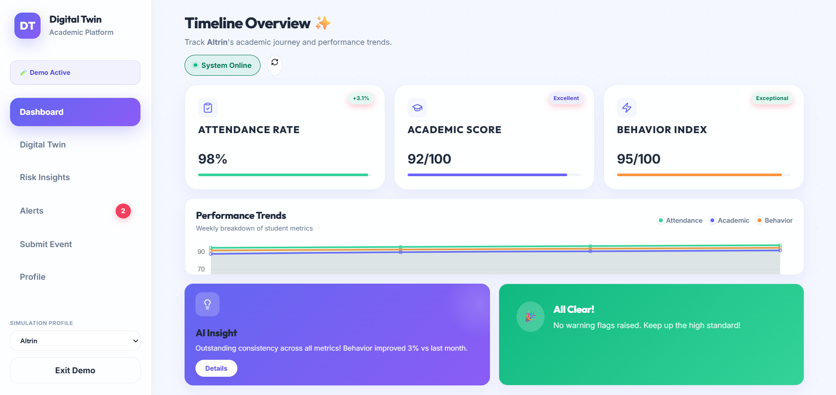
UI Design

Slide 14
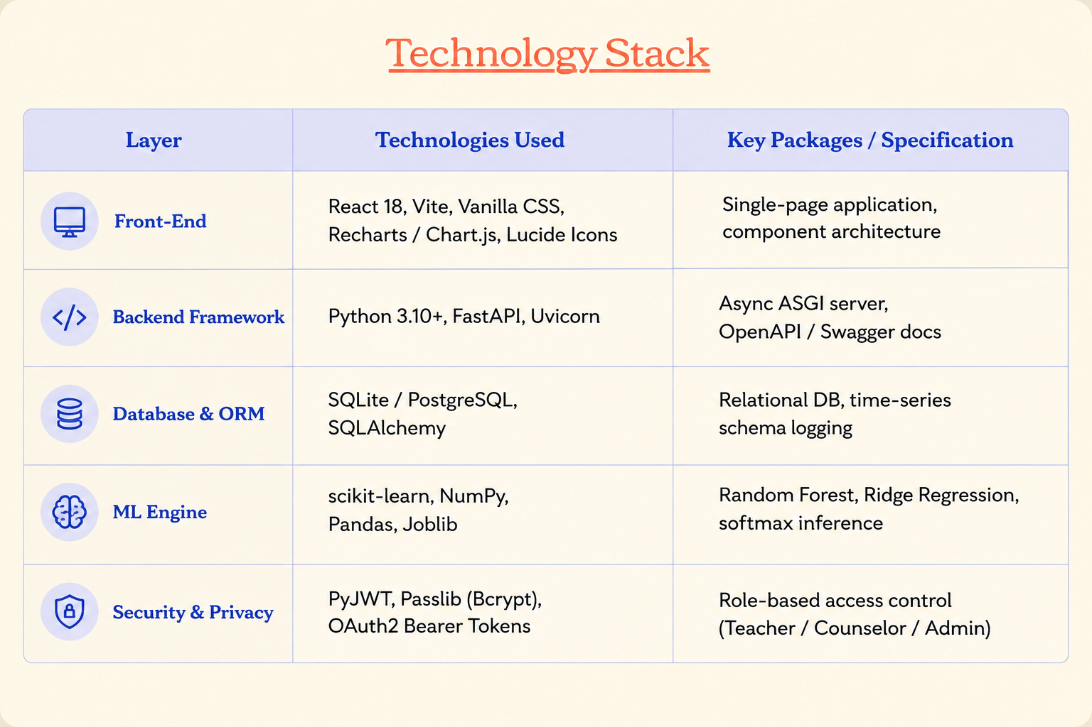
Implementation Details

Slide 15
THANK YOU

